Slide 1





Taking Action

Slide 2


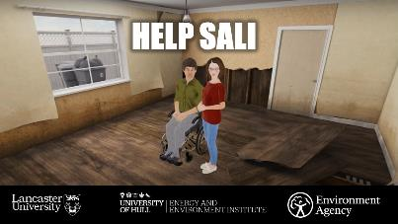
Flood Story videos and young people’s action on flooding
Notes:
In the previous two lessons we explored how flooding can impact young people and their families through the stories of Callum and Sali
We also started to explore how the young people in these flood story videos drew on their knowledge and experience of flooding to come up with ideas for action at family, local community and national level
Today we’re going to think about who is involved in managing flood risk and how – the various ‘stakeholders’ involved in flooding – and we’ll start to explore ideas for how you could get involved in action

Slide 3

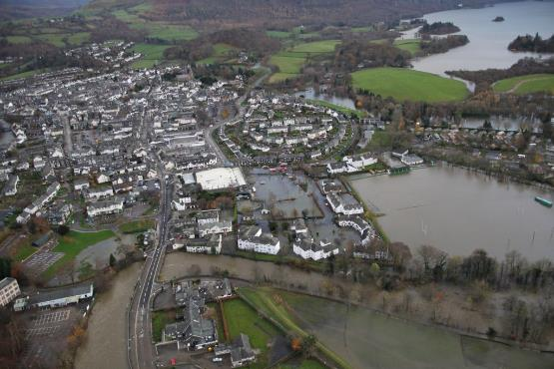
Aims for today:
Explore who is involved in action on flood risk and how
Identify a main priority for managing flood risk and start planning action

Slide 4
Learning outcomes – you will be able to:
Explain who are some of the ‘stakeholders’ in managing flood risk
Start planning action on flood risk, in response to your chosen priority

Slide 5

Notes:
Remind students of the Flood Manifestos created by Callum and Sali and the other young people involved in the flood research project
Last time we talked about their ideas for action – from individual/family level, through to local community to national, decision-maker level
Today we’re going to start by thinking more about exactly WHO is involved in action on flooding

Slide 6


Action on flooding
WHO is involved?
And HOW? (What actions can these various people / organisations take?)
Notes:
Ask students: who is involved in managing flood risk at family, local community and national level – and HOW?
Facilitate class discussion, listing ideas on the whiteboard

Slide 7

Action on flooding
[Insert here priority actions identified in previous lesson]
Notes:
Remind students of the main actions they identified last time from the Young People’s Flood Manifestos
Are there any further actions they want to add to the ones already identified?
Ask students in groups to rank these actions in priority order (using cards on which these priorities have already been written, if possible)
Groups feed back

Slide 8
Action on flooding - SMART targets
Specific
Measurable
Achievable
Relevant
Time-bound
Notes:
Introduce idea of the class taking action on one main priority.
Explain how different choices will require different kinds of action and involve different stakeholders (as noted in the previous activity).
They should think about an action that is SMART – in particular, something concrete, relevant and achievable where they think they could make a difference
They might want to think about steps they could take in their own school or locality such as creating a school flood plan or running an assembly or open day about flooding for the local community
Discuss and agree on one action (by vote or some other means)
Once the class has decided their action, students start working in groups on ideas for this action, using discussion prompts
Feed back their initial ideas

Slide 9
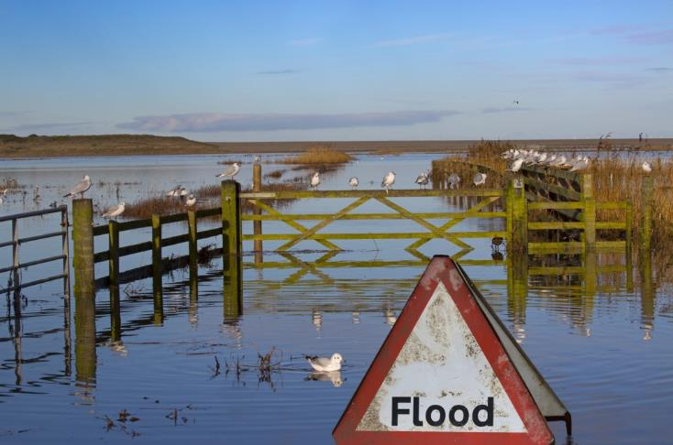
Taking action on flood risk
Notes:
Review what the students have achieved today and their plans so far, as well as the next steps required to work on their action

