Slide 1





Help Sali

Slide 2

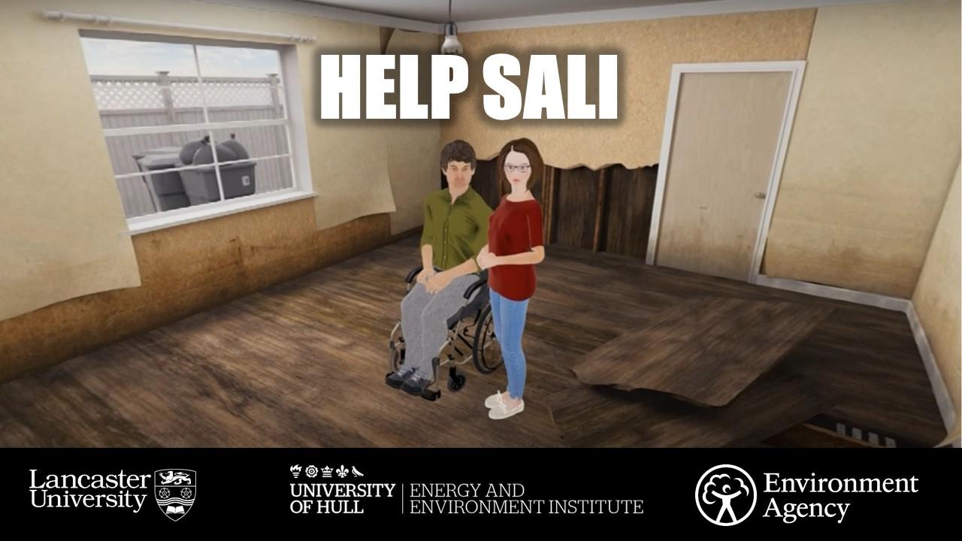
Flooding – Help Sali video
Notes:
In the last lesson we explored some of the ways that flooding can impact children and their families by learning about Callum’s story
Today we’re going to find out more about the different impacts of flooding through a different story about an 11 year old girl called Sali
Like Callum, Sali was flooded out of her home during the severe floods that took place in England during the winter of 2013-14
We’ll think about the different issues Sali’s story raises in relation to flood risk management in the UK
We’ll also think in more detail about possible actions that can be taken to help manage flood risk in the future

Slide 3
Aims for today:
Explore further the impacts of flooding on young people and families
Learn how young people have taken action on flood risk
Explore how action can be taken at different levels – from individual to national government level

Slide 4
Learning outcomes – you will be able to:
Explain more of the impacts of flooding on people’s lives
Understand the concept and purpose of a manifesto
Identify some priorities for action in flood risk management

Slide 5
Help Sali
https://www.youtube.com/watch?v=DKwHtupXS0Y
Notes:
Ask students: As you watch, think about the way Sali and her family are dealing with the situation. What would have helped them and who could provide that help?
Ask the students also to think about this story in comparison to Help Callum. What new issues are being raised that are different from Callum’s story – and what is similar?
Show the video, stopping briefly at the end of each scene to discuss these questions
Check if there are any questions following the video

Slide 6
Notes:
Callum and Sali were invited by the research team that were working with them to reflect on their own experiences of flooding and come up with a list of things they felt needed to change – at individual/family level, at local community level and at government level (both local councils and national government level). These were called ‘Flood Manifestos’ as the word ‘manifesto’ means a list of demands
The group of young people presented these manifestos to ‘stakeholders’ involved in flooding in their local community – such as those working for local councils and in the insurance sector, as well as people working in education and health
They also went on to present their manifestos at Parliament to an a group of MPs working on flooding issues
The manifestos inspired many of these stakeholders to change some of the ways they worked and how they involved children and families. For example, the British Damage Management Association which represents insurers and those working in damage repair were inspired to develop two training programmes for their staff on how to work better with families after flooding. The local council where the young people lived started involving children in emergency planning and ran training for teachers about how flooding might affect young people. The Environment Agency, which manages flood risk across England, started doing more work in schools and including children in their work to promote flood resilience among local communities
Ask students to take a look at the Flood Manifestos that the young people created and which inspired all this action. Ask them in groups to annotate copies of the Manifesto down the left-hand side, based on whether they think each action is for the individual/family, local community or decision-makers
Students then decide which action they think is the most important at each level and why
Feed back and note responses on the whiteboard

Slide 7
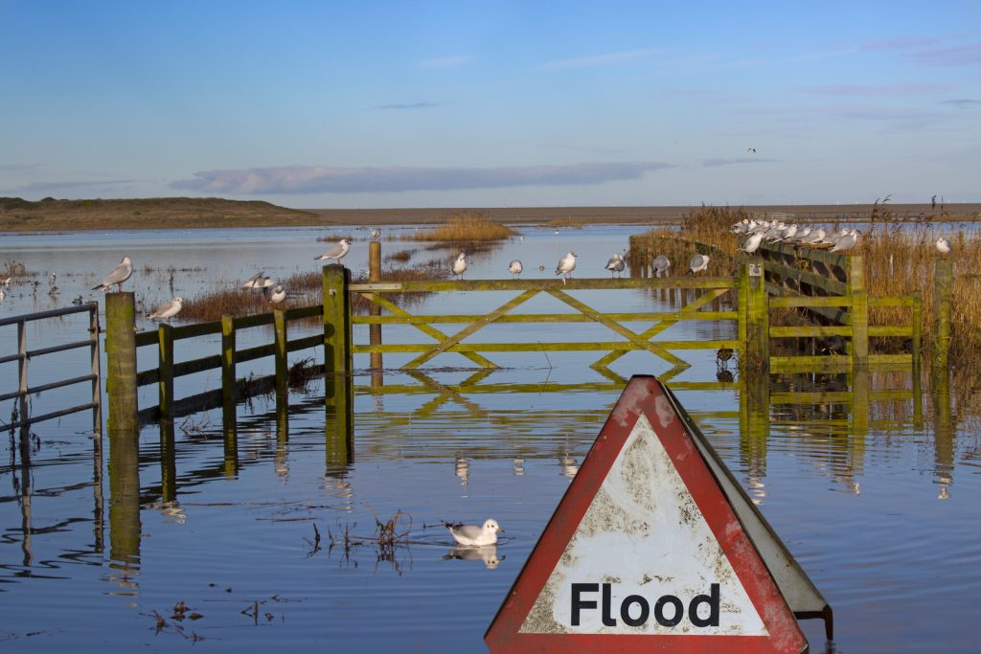
Taking action on flood risk
Notes:
Summarise the learning from today and encourage the students to keep thinking and talking about these issues, including with their friends and families
Introduce how the next lesson will focus on how students can get involved in local action on flooding and flood risk

