Slide 1





Help Callum

Slide 2

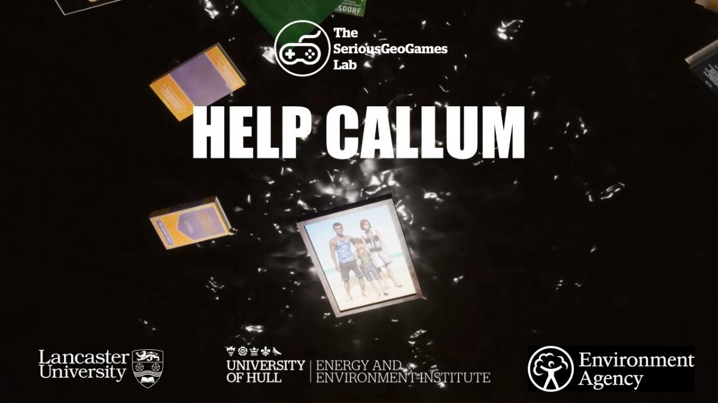
Flooding – Help Callum video
Notes:
Flooding is happening more often in Britain and around the world as a result of climate change
Today’s lesson will use a video about a boy called Callum to explore how flooding can affect people’s lives
We’ll also think about some of the steps we can take to be prepared if and when flooding happens

Slide 3


Aims for today:
Explore some of the effects of flooding on young people’s everyday lives
Identify what you can do to be better prepared for flooding

Slide 4
Learning outcomes – you will be able to:
Understand some of the social impacts of flooding, including the lengthy recovery process
Identify ways that families and communities can be better prepared for flooding

Slide 5

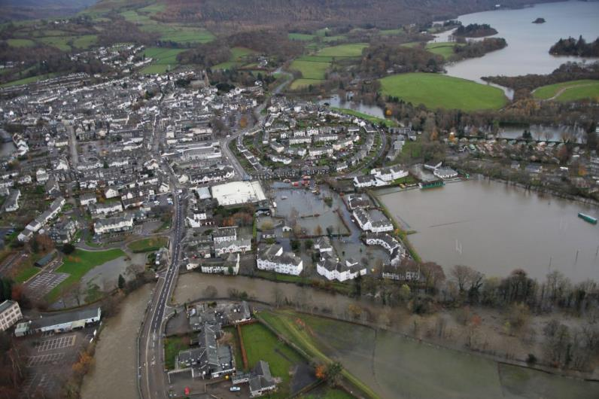

Q: How do you imagine flooding affects young people’s everyday lives?
Think about the following ‘SPHERE’ aspects or dimensions:
  Social
  Political
  Health
  Environmental
  Respect
  Economic
© SPHERE - The Winston Churchill School, Woking
Select at least 3 parts of SPHERE to look at.
Notes:
‘SPHERE’ is a useful approach to thinking about a topic or issue through different lenses. ‘Respect’ may be a new lens to think about but it’s useful in inviting us to think about our relationship with the world and the people around us. The next slide breaks down further how to ‘sphere’ this question.

Slide 6

SPHERE
Social | Political | Health | Environment | Respect | Economy
Families Community Society Nationality | Government International relations Trade Uneven development | Physical Mental Well-being NHS | Natural world Built up areas Global issues Changes to nature Human activities | Culture Race Gender Age Religion Disability | Money Jobs Industry Business
© SPHERE - The Winston Churchill School, Woking
Social | Political | Health | Environment | Respect | Economy
Families Community Society Nationality | Government International relations Trade Uneven development | Physical Mental Well-being NHS | Natural world Built up areas Global issues Changes to nature Human activities | Culture Race Gender Age Religion Disability | Money Jobs Industry Business

Slide 7

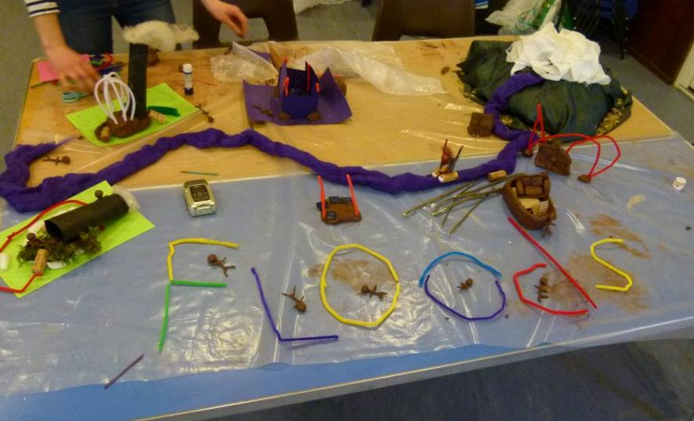
Help Callum video – how and why it was made
  Based on a true story, gathered during a research project about children and flooding
  Puts you in Callum’s shoes so you experience the floods from his perspective
  Asks you: how would you help Callum with the various challenges he faces?
Notes:
Help Callum is based on the true story of a boy who was flooded out of his home during the severe floods that took place in England during the winter of 2013-14
Researchers worked with young people like Callum (not his real name) to find out what life was like for them during and after the flood. The researchers wanted to learn from their first-hand experience how we can better support children when flooding happens
The animated video was made to share aspects of Callum’s experience that people might not be aware of. The 360/VR approach allows the viewer to see the experience from Callum’s point of view. The video aims to open up a conversation about how could others help Callum to deal with this difficult situation
Ask students: As you watch, think about what you think Callum needs at each point in the story – what help does he need and who could give him that help?

Slide 8

Help Callum
https://www.youtube.com/watch?v=4gpOOcQV1fw
Notes:
Check if there are any questions following the video and then introduce the group activity

Slide 9

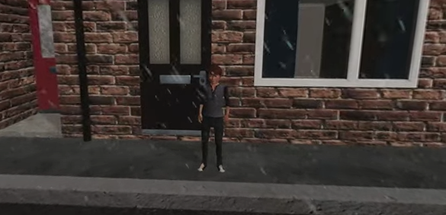
Group Activity:
How would you help Callum?

Slide 10


‘Now you’ve heard my story,
what can YOU do to be better prepared for flooding?’
In your group, identify ONE thing that you - or your family or school - can do to be better prepared for flooding.
Notes:
Remind the class of Callum’s question: ‘Now you’ve heard my story, what can YOU do to be better prepared for flooding?’
Reflect with the students on the key issues or themes that have emerged during the lesson and ask them to think about they see as the priority issues
Wrap up lesson by summarising learning and introducing how next time we will focus on translating ideas for change into action
Encourage students to keep thinking and talking about what they learned today, including with their friends and families

